Slide 1
EMPLOYEE MANAGEMENT SYSTEM - SRINIVAS -RAMYA -CHINNIBABU

Slide 2
Employee management system –
An employee management system is a software, that helps your employees to give their best efforts every day to achieve the goals of your organization. It guides and manages employees efforts in the right direction. It also securely stores and manages personal and other work-related details for your employees.

Slide 3
The objective of “Employee Management System” is designing a scheduling system for a work centre. Scheduling is such a tool with which the process of intimating activities and notifications will be easy and even online in the organization where it is installed.

Slide 4
Using software
FRONT END: HTML, CSS
BACK END: SPRING BOOT
DATABASE: ORACLE SQL

Slide 5
Some of the common benefits of having an EMS in your organization are –
Efficiency And Better Accuracy.
Fewer Compliance Risks.
Boosted Profitability.
Very Few Manual Errors.
Higher Productivity.
Higher Motivation.
Lower Costs.

Slide 6
Step1: We have created login page using html with springboot by user enter username and password.
Step2: Add employee
Step3: we will enter details of employees and click on submit button.
Step4: next page shows the employee details. Next we will do edit and delete of employee details.

Slide 7
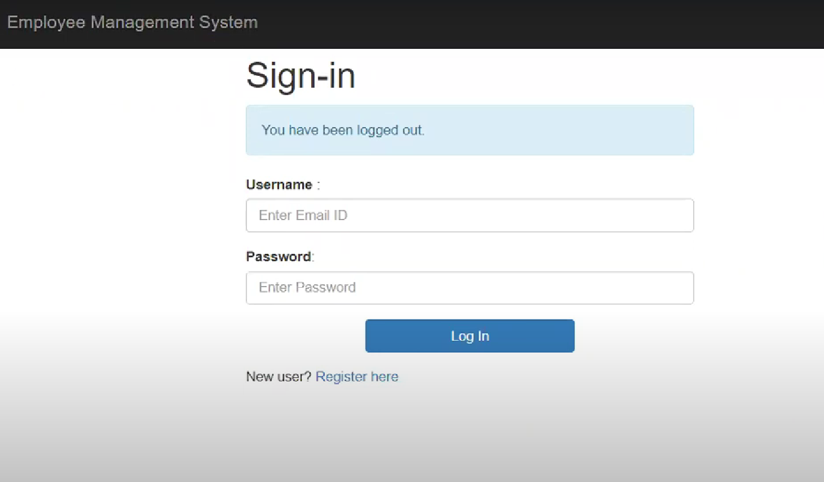
Login page

Slide 8
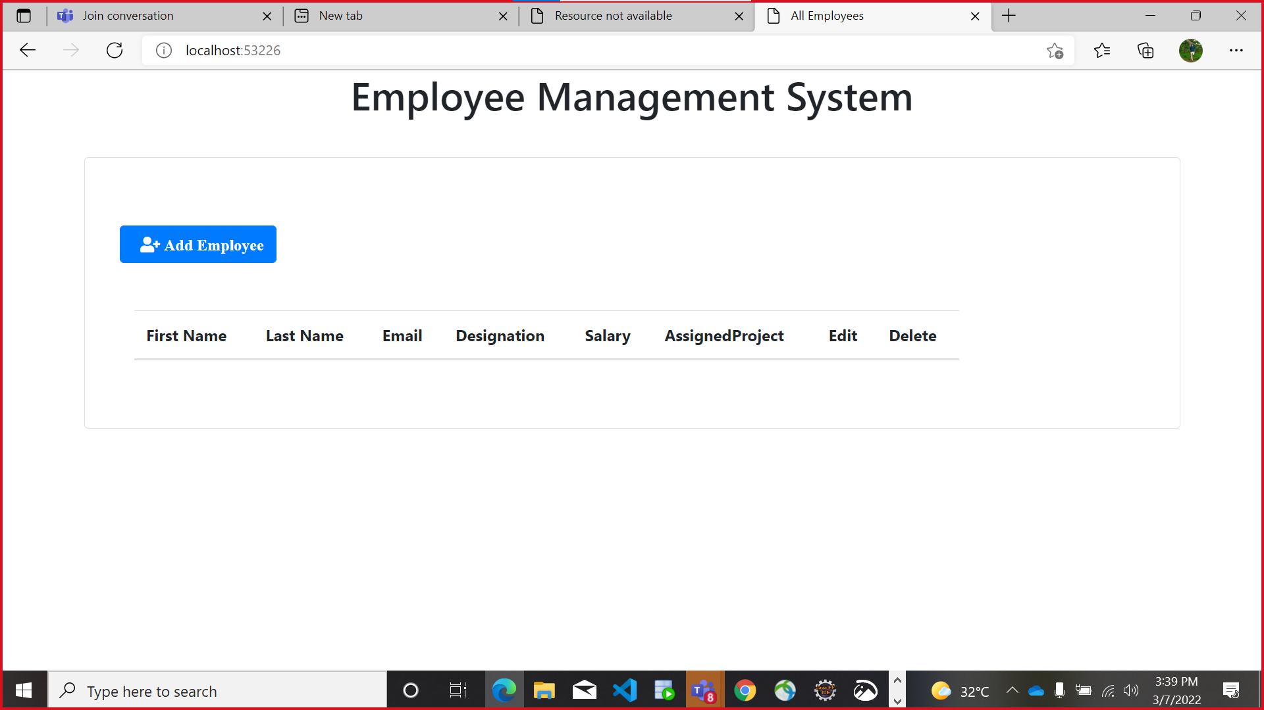

Slide 9
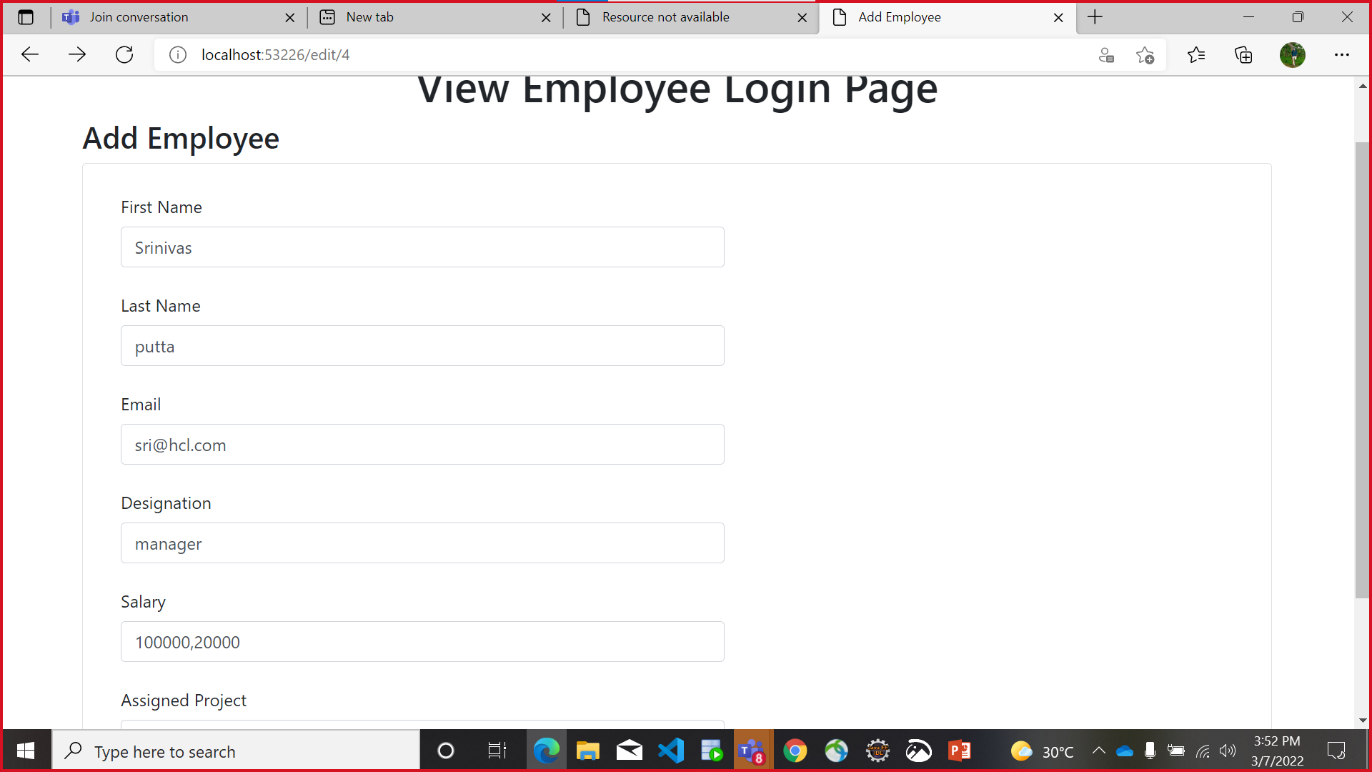

Slide 10
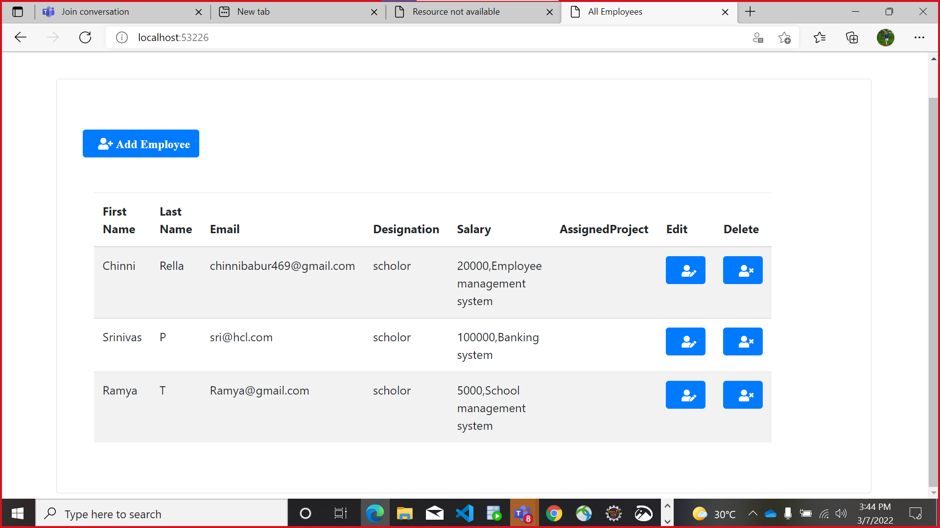

Slide 11
THANK YOU

